Slide 1
R Programming Course
3. Programming Concepts

Slide 2
R Programming Course
3.1 Programming Concepts
R is a computer language which is processed by a special program called an interpreter.
This program reads and evaluates R language expressions, and prints the values determined for the expressions.
The interpreter indicates that it is expecting input by printing its prompt at the start of a line.
By default, the R prompt is a greater than sign >.

Slide 3
R Programming Course
3.1 Programming Concepts - continued
R can be used as a Calculator
For grouping and evaluation. normal arithmetic rules apply; multiplication and division occur before addition and subtraction.
Operator precedence
Operator | Description
^ | Exponentiation
- + | unary minus and plus
: | sequence operator
%/% %% | integer division, remainder
* / | multiplication, division
+ - | addition, subtraction
Evaluation of equal precedence takes place left-to-right (except for exponentiation, which takes place right-to-left)

Slide 4
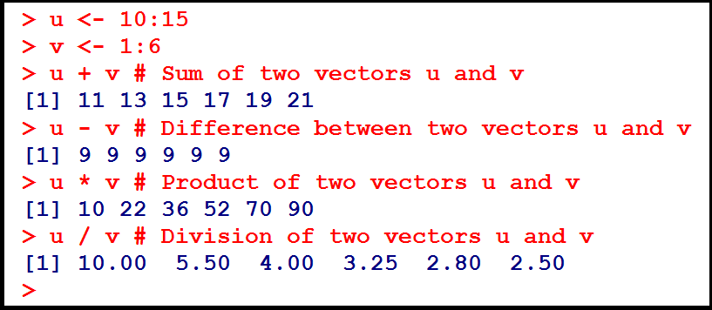
R Programming Course
3.2 Vectorized calculations
Element-wise Operations on Vectors
Suppose we have a function f() that we wish to apply to all elements of a vector x.

Slide 5
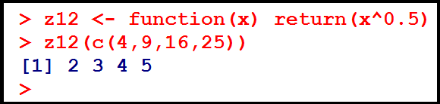
R Programming Course
3.2 Vectorized calculations - continued
Element-wise Operations on Vectors – continued.
In many cases, we can accomplish this by simply calling f() on x itself.

Slide 6


R Programming Course
3.2 Vectorized calculations - continued
Filtering
Here is what happened: We asked R to find the indices of all the elements of z whose squares were greater than 20, then use those indices in an indexing operation on z, then finally assign the result to w.
We may just want to find the positions within z at which the condition occurs. We can do this using which():

Slide 7
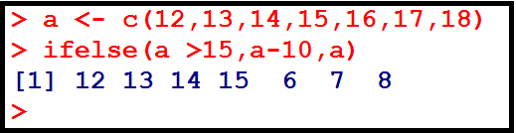
R Programming Course
3.2 Vectorized calculations - continued
Filtering
The form is ifelse(b,u,v) where b is a boolean vector, and u and v are vectors.
The return value is a vector, element i of which is u[i] if b[i] is true, or v[i] if b[i] is false.

Slide 8
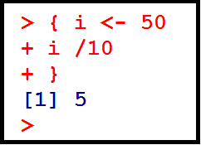
R Programming Course
3.3 Control structures
Computation in R consists of sequentially evaluating statements.
Statements, such as x <- 10:100 or mean(x), can be separated by either a semi-colon or a new line.
Statements can be grouped together using braces '{' and '}'. A group of statements is called a block. Single statements are evaluated when a new line is typed at the end of the syntactically complete statement.

Slide 9
R Programming Course
3.3 Control structures - continued
The following are the basic control-flow constructs of the R language:
They function in much the same way as control statements in any programming language.
a. Statements that perform testing that shifts flow
1. if statements
2. switch statements
b. Statements that perform / control looping
1. for
2. while
3. repeat
4. break
5. next

Slide 10
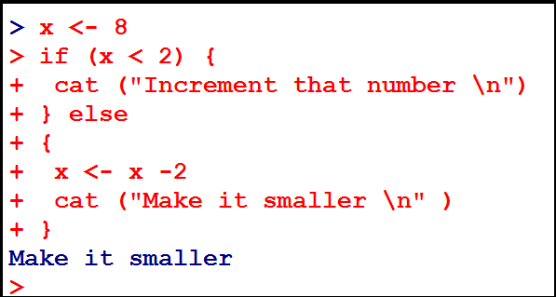
R Programming Course
3.3 Control structures - continued

Slide 11
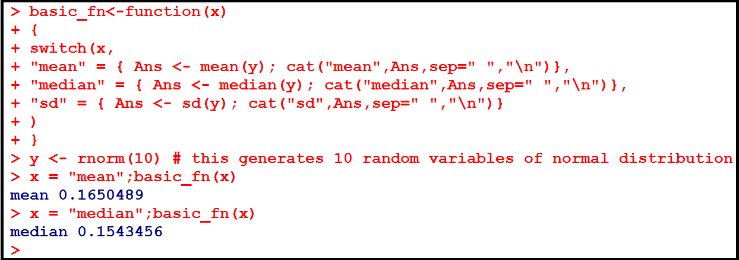
R Programming Course
3.3 Control structures - continued

Slide 12
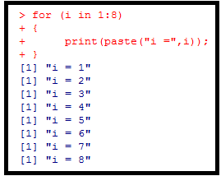
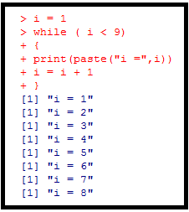
R Programming Course
3.3 Control structures - continued

Slide 13
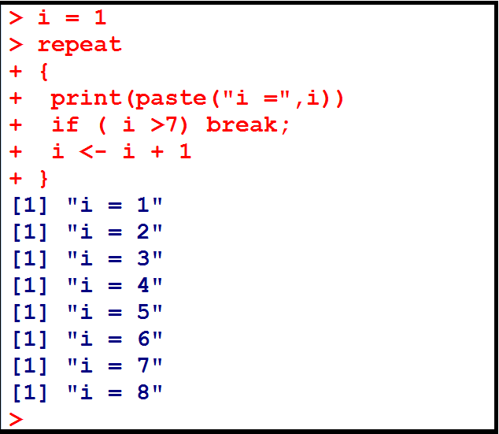
R Programming Course
3.3 Control structures - continued
The break statement breaks out of a for, while or repeat loop.

Slide 14
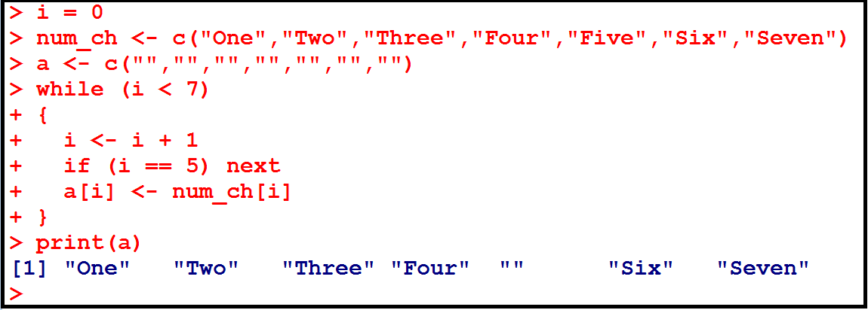
R Programming Course
3.3 Control structures - continued
The next statement halts the processing of the current iteration and advances the looping index.

Slide 15
R Programming Course
3.4 Scoping rules
The symbols which occur in the body of a function can be divided into three classes:
formal parameters
local variables
free variables
The formal parameters of a function are those occurring in the argument list of the function.
Their values are determined by the process of binding the actual function arguments to the formal parameters.

Slide 16
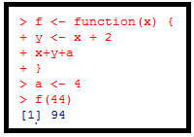
R Programming Course
3.4 Scoping rules - continued
Local variables are those whose values are determined by the evaluation of expression in the body of the functions.
Variables which are not formal parameters or local variables are called free variables.
In this function, f
x is a formal parameter,
y is a local variable and
a is a free variable

Slide 17
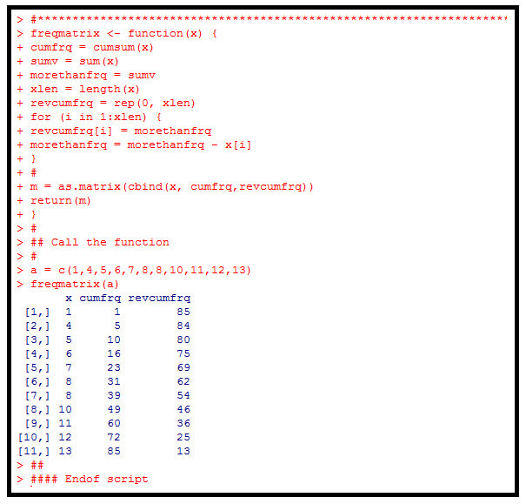
R Programming Course
3.5 Writing functions
The syntax for writing a function is
function (arglist) body

Slide 18
R Programming Course
3.5 Writing functions - continued
The first component of the function declaration is the keyword function which indicates to R that you want to R that you want to create a function.
An argument list is a comma separated list of formal arguments. A formal argument can be a symbol, a statement of the form ‘symbol = expression’, or the special formal argument ‘....’.
The body can be any valid R expression. Generally, the body is a group of expressions contained in curly braces ‘{‘ and ‘}’.

Slide 19
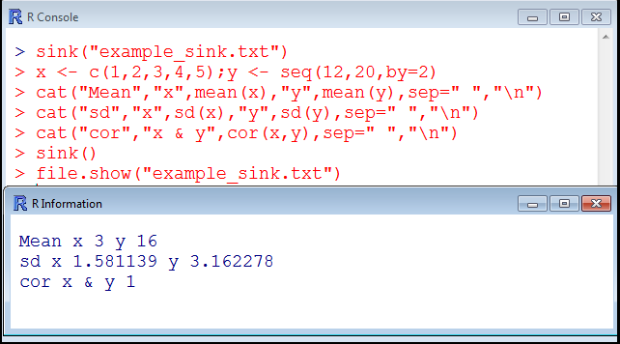
R Programming Course
3.6 Directing console output to a file
sink(file) diverts R output to a connection; where file is a writable connection or a character string naming the file to write to, or NULL to stop sink-ing.
The command file.show displays one or more files.

Slide 20
R Programming Course
3.7 File operations
R recognizes a variety of formats for reading in data.
For tabular data, the basic command "read.table" offers a powerful range of options.
Short form commands "read.csv" and "read.delim" for reading in comma-separated variable (output from a spreadsheet) and tab-delimited format data, respectively.
Similarly, the command "write.table" is available to output tabular format data.

Slide 21
R Programming Course
3.7 File operations - continued
For fixed-width format data, use "read.fwf".
A powerful "scan" command is available to read in data directly into a vector or list.
See their respective help pages for details.
Command - read.table reads a file in table format and creates a data frame from it, with cases corresponding to lines and variables to fields in the file.

Slide 22
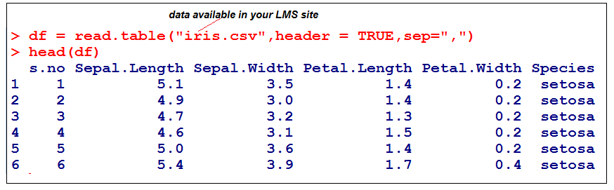
R Programming Course
3.7 File operations - continued
Arguments for read.table
file - the name of the file which the data are to be read from
header - a logical value indicating whether the file contains the names of the variables as its first line
sep - the field separator character. Values on each line of the file are separated by this character

Slide 23
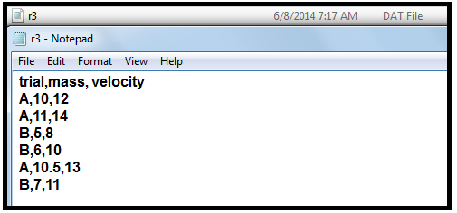
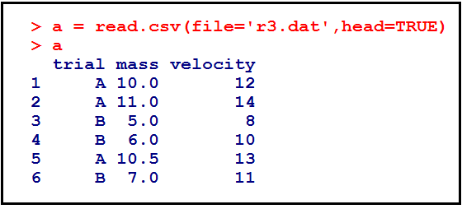
R Programming Course
3.7 File operations - continued
The following command will read in the data and assign it to a variable called “a”.
Last line in r3.dat is a blank line.

Slide 24
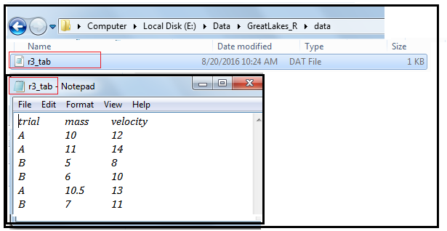
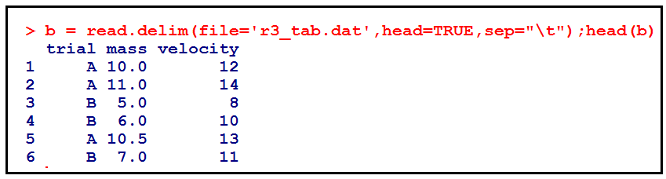
R Programming Course
3.7 File operations - continued
The following command will read in the tab-delimited data and assign it to a variable called “b”. Last line in r3.dat is a blank line.

Slide 25
R Programming Course
3.7 File operations - continued
Fixed width file - Here, the data is organized in flat files and delimited at preset locations on each line.
The command to deal with these kind of files is read.fwf, which reads a table of fixes width formatted data into a data frame.
Usage: read.fwf(file, widths, header = FALSE,col.names,nrows)
file - the name of the file which the data are to be read from
widths - integer vector, giving the widths of the fixed-width fields of one line Negative number denotes ignore
header - a logical value indicating whether the file contains the names of the variables as its first line
col.names - a vector for optional names for variables
nrows – maximum number of rows to read in

Slide 26
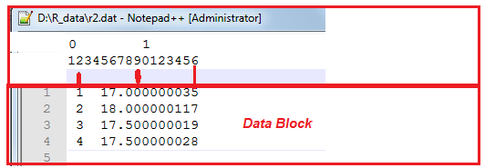
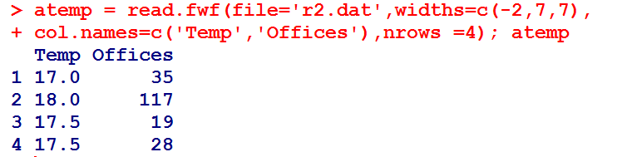
R Programming Course
3.7 File operations - continued

Slide 27
R Programming Course
3.7 File operations - continued
Scan
Reading very small data from the console
Inputting a text file
Usage: scan(file, what = double(),sep="")
file - the name of the file to read data values from; if it is "", input is from keyboard
what - the type of data to be read. Accepted values are logical, integer, numeric, complex, character, raw and list
sep - a character which delimits the fields; default ""
nmax - integer; the maximum number of data values to be read; if what is a list, maximum number of data records to be read

Slide 28
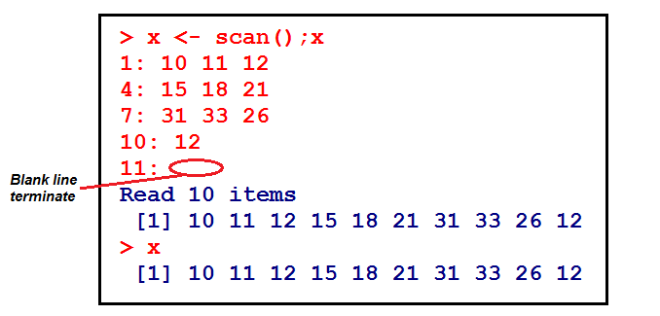
R Programming Course
3.7 File operations - continued
Scan - continued
Reading very small data from the console

Slide 29
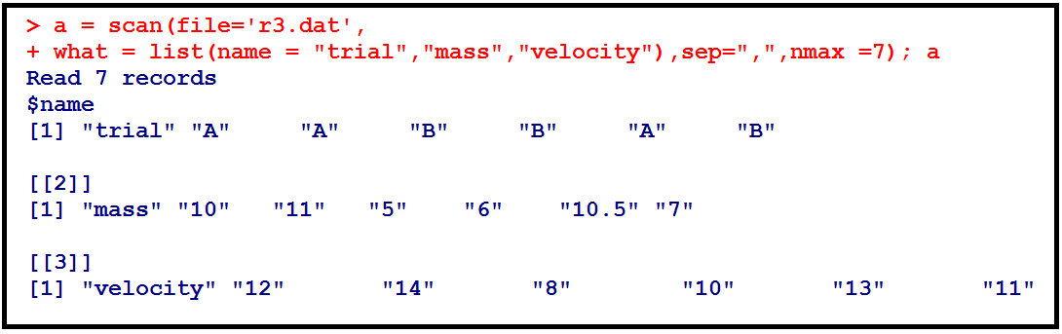
R Programming Course
3.7 File operations - continued
Scan - continued
2) Inputting a text file

Slide 30
R Programming Course
3.7 File operations - continued
The function write.table writes file, an object typically a data frame but this could well be another kind of object vector, matrix,…).
Usage:
write.table(x,file = "",append = FALSE,quote=TRUE, sep = " ", eol = "\n", na = "NA", row.names = TRUE, col.names = TRUE, qmethod = c("escape","double")
x - the object to be written
file - file name or connection open for writing; " " console output
append – logical; If TRUE, the output is appended to the file
quote - logical value or numeric vector; if TRUE, any character or factor columns will be surrounded by double quotes. If numeric vector, its elements are taken as the indices of columns to quote
sep – the field separator string
eol - the character(s) to print at the end of each line (row)

Slide 31
R Programming Course
3.7 File operations - continued
Usage continued:
write.table(x,file = "",append = FALSE,quote=TRUE, sep = " ", eol = "\n", na = "NA", row.names = TRUE, col.names = TRUE, qmethod = c("escape","double")
row.names - either a logical value indicating whether the row names of x are to be written along with x, or a character vector of row names to be written
col.names – either a logical value indicating whether the column names of x are to be written along with x, or a character vector of column names to be written
qmethod - a character string specifying how to deal with embedded double quote characters when quoting strings - For example - quote character is escaped in C style or it is doubled

Slide 32
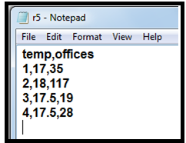
R Programming Course
3.7 File operations - continued

Slide 33
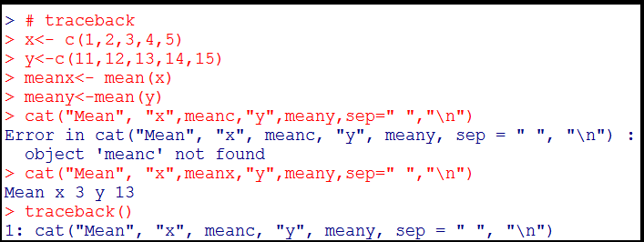
R Programming Course
3.8 Debugging
Let us make a mistake in the following R script, by replacing meana with meanc, which is non-existent.
The traceback() function prints call stack, the list of functions which were called before the error occurred.

Slide 34

R Programming Course

Slide 35
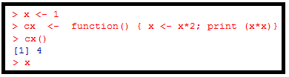
R Programming Course
The following R code changes the value of its argument inside the function. What it is the value of x after running the below piece of R code:
4
2
1
None of the above

Slide 36

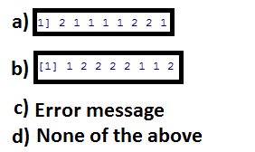
R Programming Course
The output after running the following R code is

Slide 37
R Programming Course
c)
b)

Slide 38

R Programming Course

Slide 39
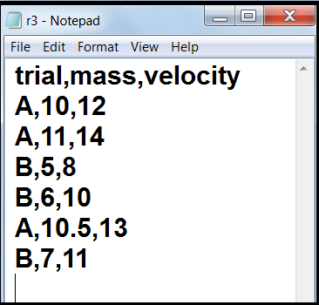
R Programming Course
Lab Exercise 1:
Read the csv type file with name “r3.dat” into an object a and print its contents.
The file r3.dat and available in your local drive under the folder data.

Slide 40
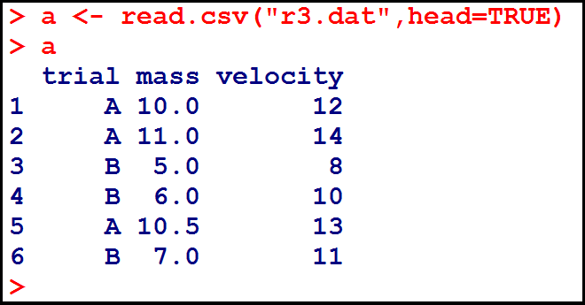
R Programming Course
Lab Exercise 1 - continued:
The command to read the data file is read.csv.
The first argument is the name of the file.
The second argument indicates whether or not the first row is a set of labels.

Slide 41
R Programming Course
Lab Exercise 2:
Assume you are processing the examination results of the BTech - IT students.
You have the Roll number, name, marks (max=100) in each of the five exam papers.
You declare the result as "pass", if the student gets not less than 50 in each paper; if the student gets less than 50 marks, the result is "fail".
Print a tabulated mark register containing the following details:
1. Serial Number
Roll number
Name of the student
4. Marks obtained in each of the five exam papers
5. Result

Slide 42
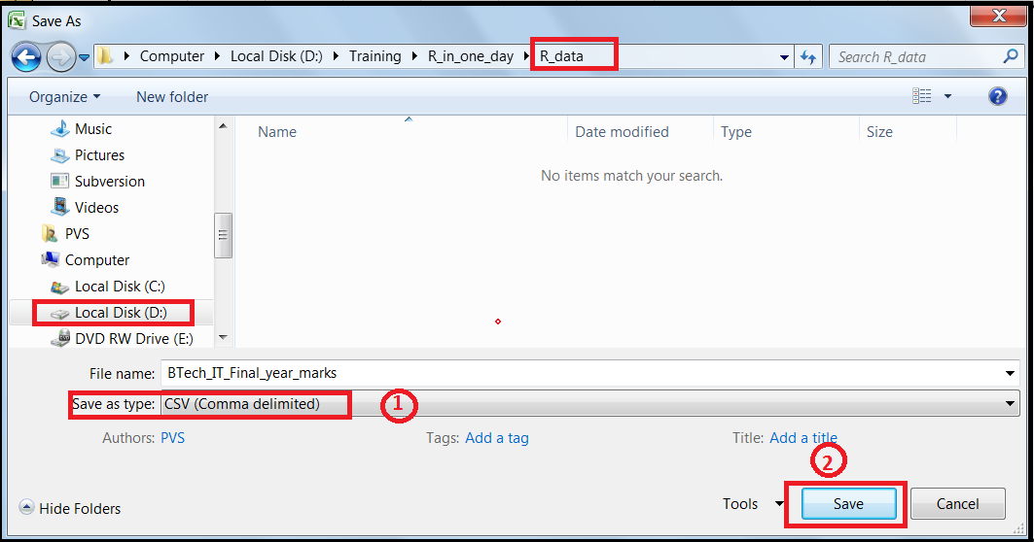
R Programming Course
Lab Exercise 2- continued:
The file “Btech_IT_Final_year_marks” is an excel file containing the data.
Convert the same to a csv file as follows:

Slide 43
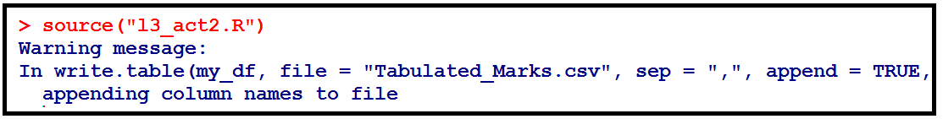
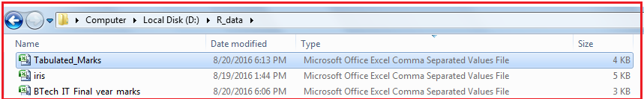
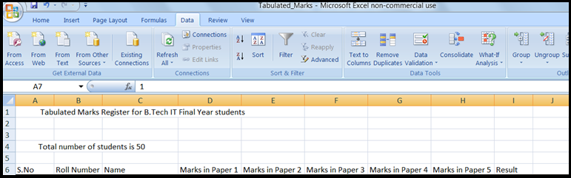
R Programming Course
Lab Exercise 2- continued:

Slide 44
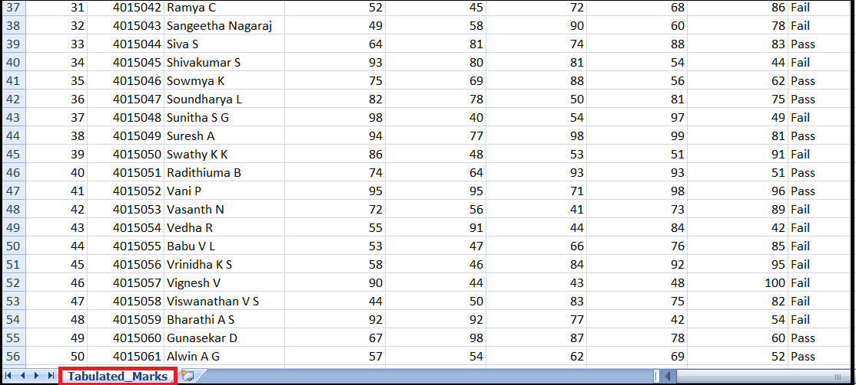
R Programming Course
Lab Exercise 2- continued:

Slide 45
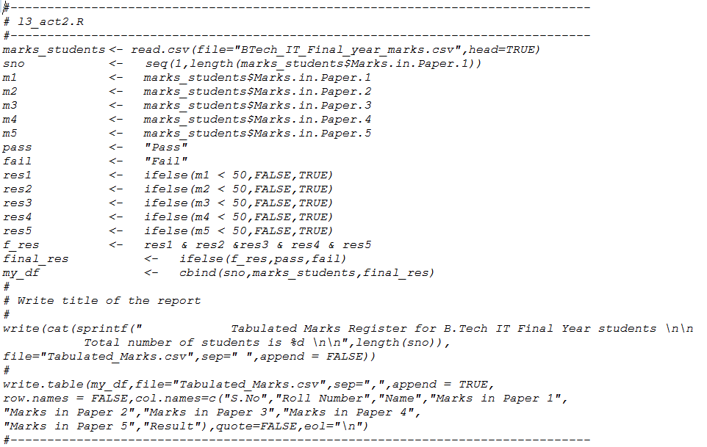
R Programming Course
Lab Exercise 2- continued:

Slide 46
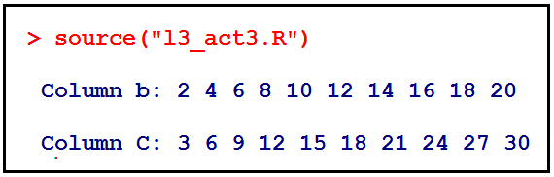
R Programming Course
Lab Exercise 3:
Use excel sheet data_test1.xlsx
Read first 10 rows from columns B & C and print

Slide 47
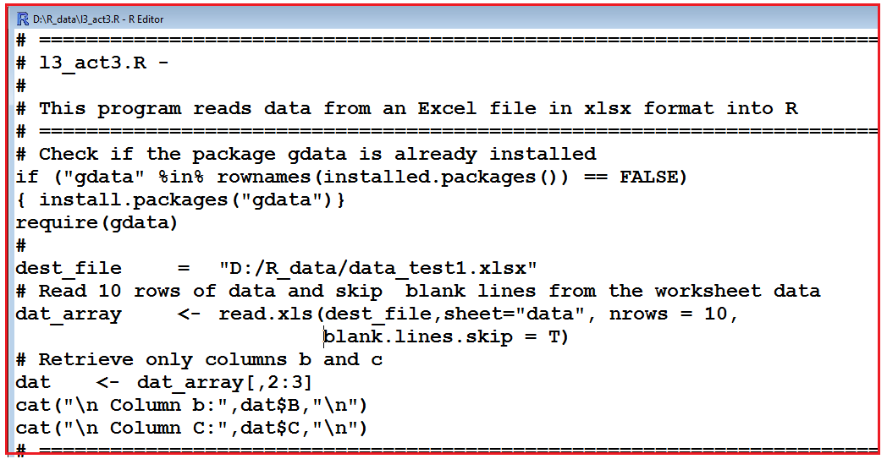
R Programming Course
Lab Exercise 3 continued:

Slide 48
R Programming Course
Activity 1:
Refer to the file
“U05_R Programming_v1.pdf“

